Slide 1
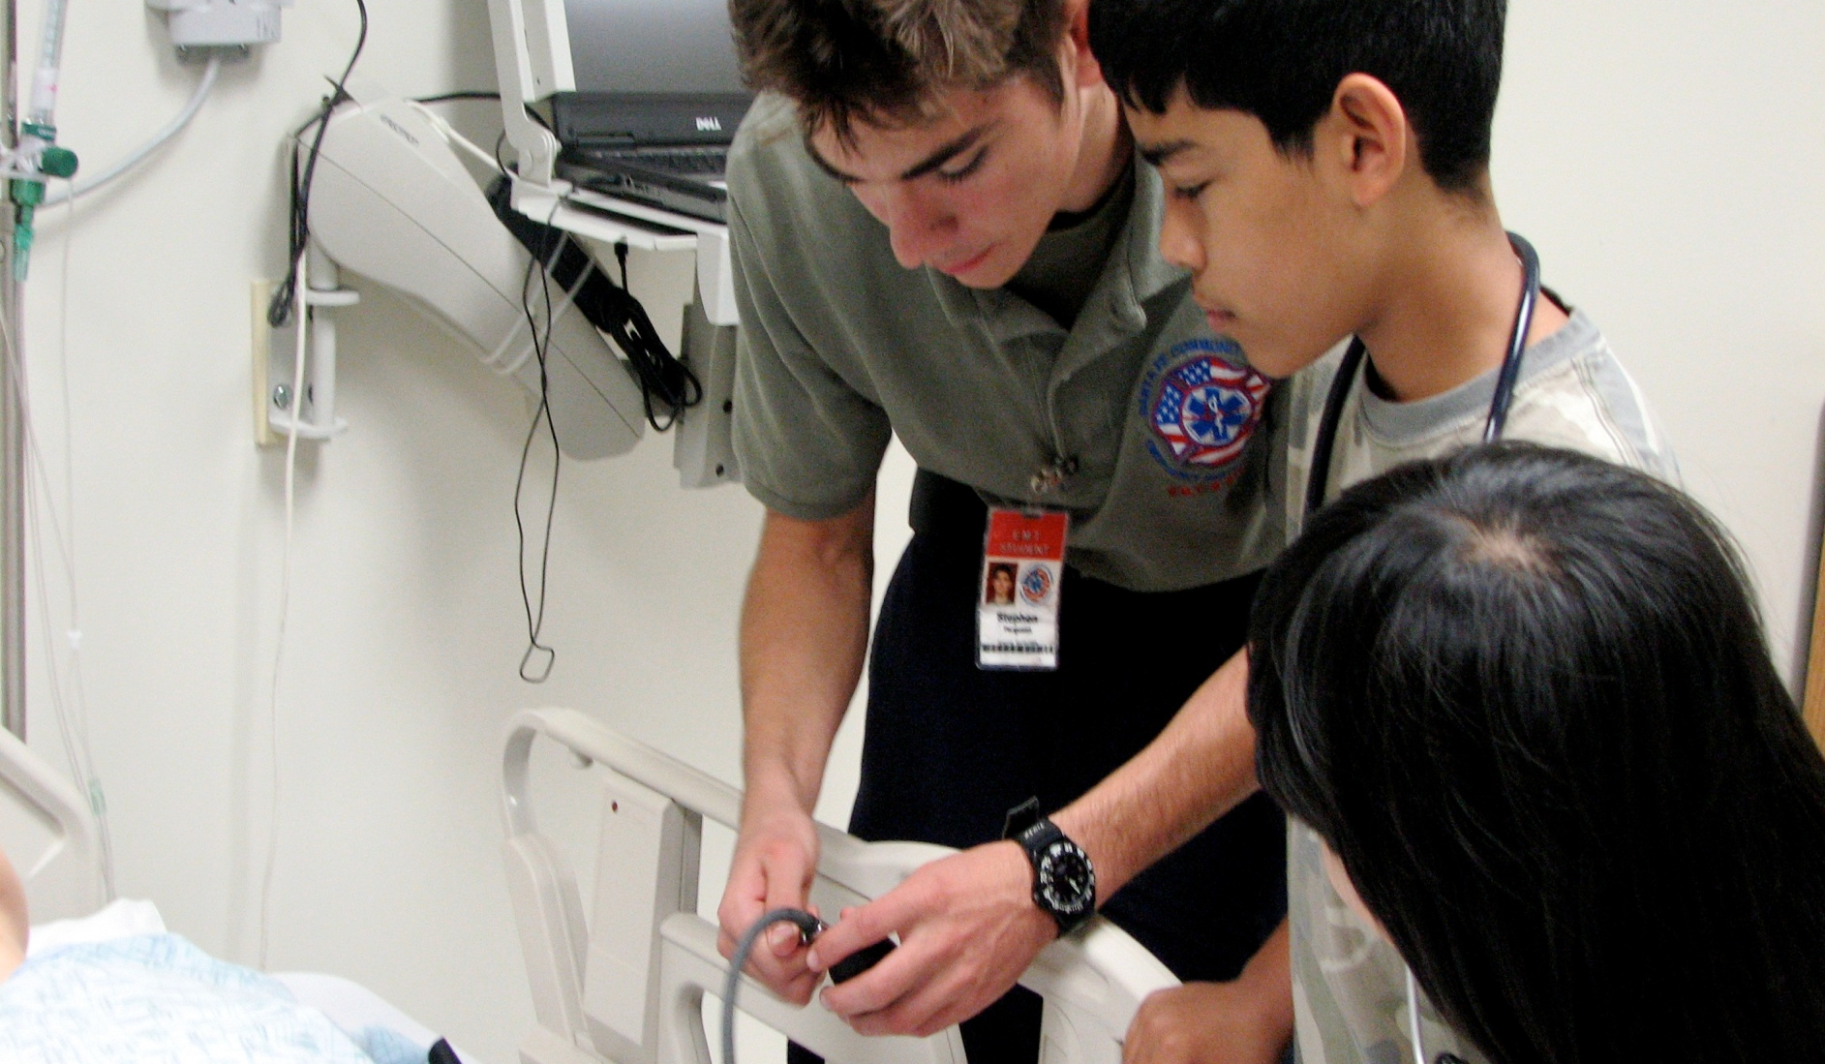
Alachua County Public Schools
2020-21 HIGH SCHOOL PLANNING

Slide 2
All Students Must Now Graduate From High School COLLEGE READY
For the first time in Florida history high school graduation requirements and college readiness requirements are the same.
High school graduation requirements change every year.
  The graduation requirements that a student must meet are determined
  by the 9th cohort group with whom they enter high school
  Students and parents are best advised to gather information regarding
  graduation requirements from a middle or high school counselor or
  from the Florida Department of Education (fldoe.org)
  Students and parents are advised not to take their guidance regarding
  graduation requirements from high school students and teachers

Slide 3
High School Graduation
Requirements for a Standard Diploma
Florida students entering high school may choose from the following options to earn a standard diploma:
4-year, 24 credit diploma program *
18 credit diploma program (ACCEL)
18 credit Career and Technical Pathway
Advanced International Certificate of Education
(AICE/Cambridge) program *
International Baccalaureate (IB) Diploma Program *
* Most students will pursue one of the 4-year, 24 credit diploma options because
these diploma options:
- maximize student opportunities to earn free college credit during high school
- improve opportunities for admission to competitive four year colleges and
universities

Slide 4
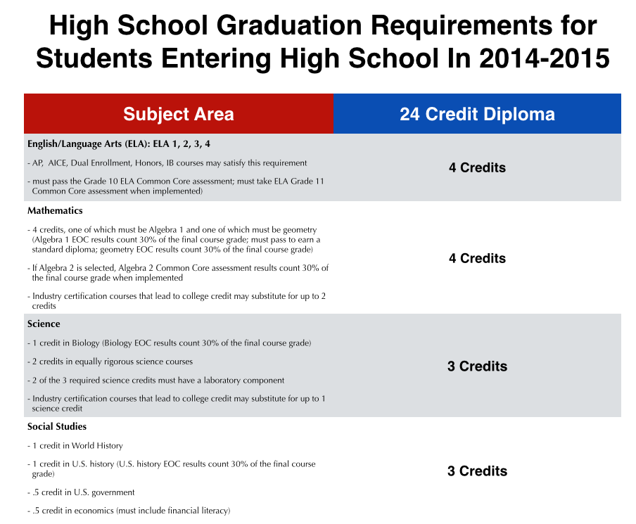
Graduation Requirements for Students Entering High School in 2020-21

Slide 5
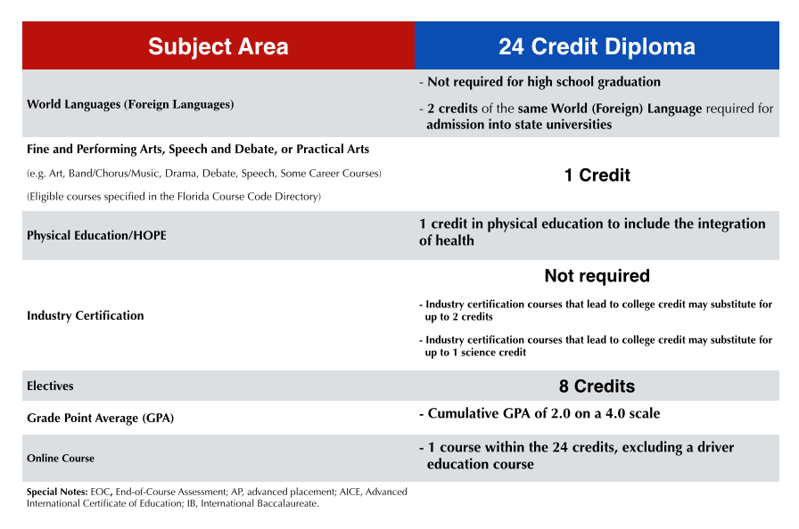
Graduation Requirements for Students Entering High School in 2020-21

Slide 6

Online Course Requirement
for a Standard Diploma
1 online course is required as part of the 24 credit requirement – may include driver’s education.
Students may also earn the online credit through participation in a career/technical course in which they earn an industry certification that meets this standard.
Note: Students graduating with an AICE, IB or 18 credit ACCEL or CTE diploma are exempt from the online course requirement.

Slide 7

World (Foreign) Language Requirement for 4 Year College Admission
Students must complete 2 course credits in the SAME
World (Foreign) Language during high school to meet the
admission requirement for a 4 year college or university. **Students do not need a world language credit to graduate high school
High school athletes should know that 2 course credits in the
SAME World (Foreign) Language during high school are required
to meet NCAA requirements to participate in college athletic
programs

Slide 8
High School Graduation Requirements
Diploma Designations
Scholar Designation
Merit Designation
In addition to meeting the standard high school diploma requirements:
Earn one credit in Algebra 2 or an equally rigorous course
Pass the geometry EOC
Earn one credit in statistics or an equally rigorous mathematics course
Pass the Biology 1 EOC
Earn one credit in chemistry or physics
Earn one credit in a course equally rigorous to chemistry or physics
Pass the U.S. History EOC
Earn two credits in the same world language
Earn at least one credit in AP, IB, AICE, or a dual enrollment course
In addition to meeting the standard high school diploma requirements:
Attain one or more industry certifications from the list established. ( per 1003.492 F.s)

Slide 9
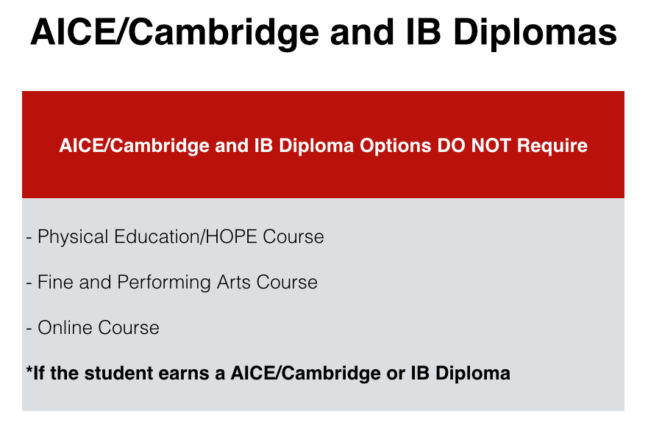

Slide 10
18 Credit Options
ACCEL Program
Career and Technology Pathway
All core courses and graduation requirements for a standard diploma must be met
EXCEPT:
PE is not required
Only 3 electives are required
Online course is not required
All core courses for a standard diploma must be met
EXCEPT:
PE is not required
Performing art is not required
Online course is not required
4 electives are required including 2 CTE courses resulting in course completion and industry certification and 2 electives in work based learning programs or other electives.

Slide 11

18 Credit Options
The 18 credit option is not recommended for all students
Reduces the opportunity students have to earn college credit through dual enrollment, AP, AICE and IB at no cost to the student
May make a student less competitive for admission to Colleges or Universities
May not be accepted by out of state colleges/universities
Must consult with NCAA for eligibility requirements

Slide 12
TESTING REQUIREMENTS
English/Language Arts– 10th grade Florida Standards Assessment
Algebra 1 EOC– Must pass and 30% of Course Grade
Geometry EOC– 30% of Course Grade
Biology 1 EOC– 30% of Course Grade
US History EOC– 30% of Course Grade
YOU MUST ALSO HAVE A 2.0 OR HIGHER GPA
(C Average)

Slide 13
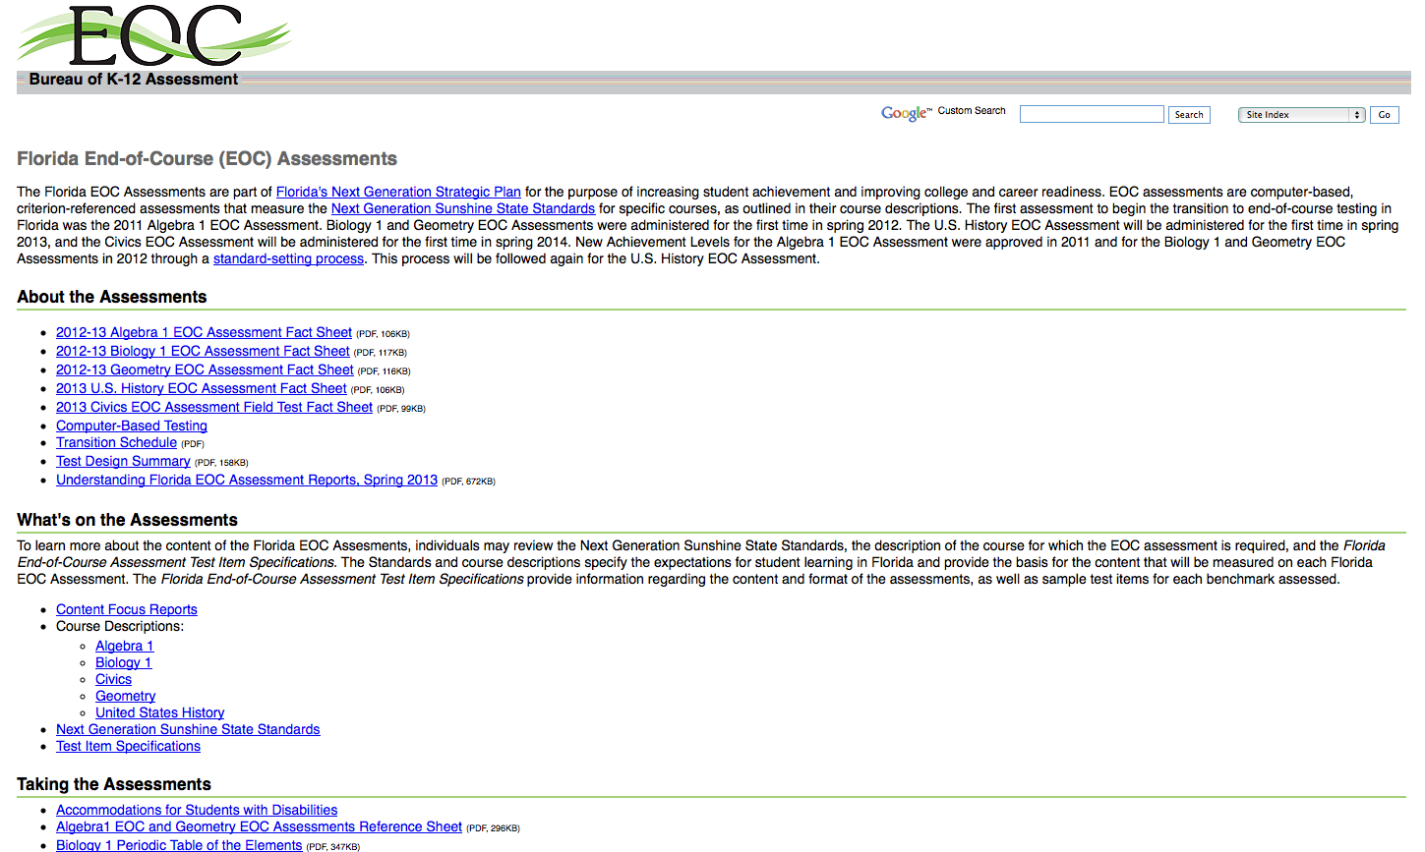
Important Parent Information

Slide 14
Be ready for Change!
The Florida Legislature reserves the right to make changes any time it wants and DOES. It is important to stay up-to-date with school counselors AND FLDOE (http://www.fldoe.org/academics/graduation-requirements).

Slide 15
Earning Academic College Credit
During High School
One of the BEST WAYS to contain COLLEGE COSTS is to earn ACADEMIC COLLEGE CREDIT during high school.
Students can earn college credit by taking courses in the following areas AND earning passing scores on end of course exams:
International Baccalaureate Program (IB) – Eastside High
AICE/Cambridge - Gainesville High
Advance Placement (AP) – All high schools
Dual Enrollment – For Students in Grades 11 & 12
- SFC Dual Enrollment – Must apply and pass Grade 10 FSA Reading, have a good attendance
and discipline record, take the PERT college placement test.
- UF Dual Enrollment – Must complete the full application packet (5 forms), have a minimum
grade point average or 3.6, earn minimum University Ready test scores
on the ACT or SAT tests, and receive the approval of the school
counselor, Supervisor of Student Services, and UF CPET office.

Slide 16


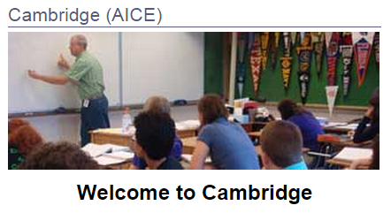
Academic Magnets
IB Program – Eastside High
Cambridge Program – Gainesville High
Notes:
We have two academic magnets. These programs are best for students who want to stretch across academics. These programs will be visiting our school so you can get more information about each one. You can also attend their open houses. Both allow you to graduate with special diplomas and earn college credit if you pass the related tests.

Slide 17
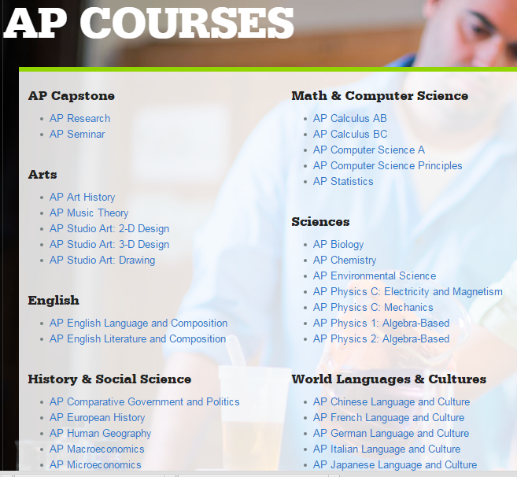
Advanced Placement Courses
Available at ALL high schools
College Credit is awarded after passing a test
Choose AP classes based on your strengths and teacher recommendation.
Notes:
You can select them based on where your strengths are. If you are good at science you may want to take an AP Environmental Science Course. At the end of the year you will take a test to earn college credit in these courses.

Slide 18


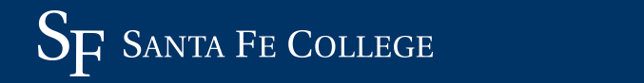
Dual Enrollment
Eligible in 11th and 12th grades
Keep up grades and behavior
Can earn college credits as well as complete high school graduation requirements

Slide 19
Earning Technical College Credit During High School
Career Academy, Career Pathways and Santa Fe College Dual Enrollment Programs help students to earn both ACADEMIC and TECHNICAL COLLEGE CREDIT during high school.
Students entering any of our Career Academy programs can earn as many as 9 college credits by earning a grade of B or better in most courses and passing a final exam with a grade of B or better or earning an articulated industry certification. Most college credits results generate a college transcript through Santa Fe College that will be accepted by most colleges throughout the country.
In addition, many schools have career/technical courses outside of the magnet programs.

Slide 20

Career Academies and Industry Certifications also allow you to earn college credit!
Career Academies

Slide 21
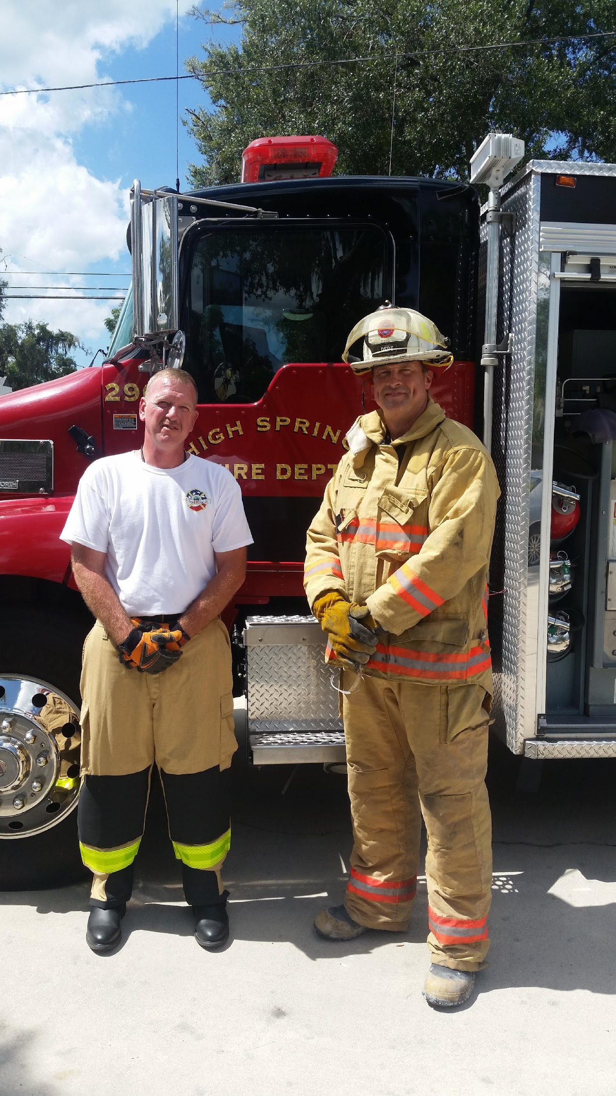
What Makes Career Academies Unique?
Taught by teachers who have worked in the career field that they are teaching in: Example: Chief Smith – Academy of Fire & EMS
Classrooms look like the actual work environment that students are training to work in
Allow you to earn college credit during high school - you can leave with industry certifications and a jump start on a college career pathway

Slide 22
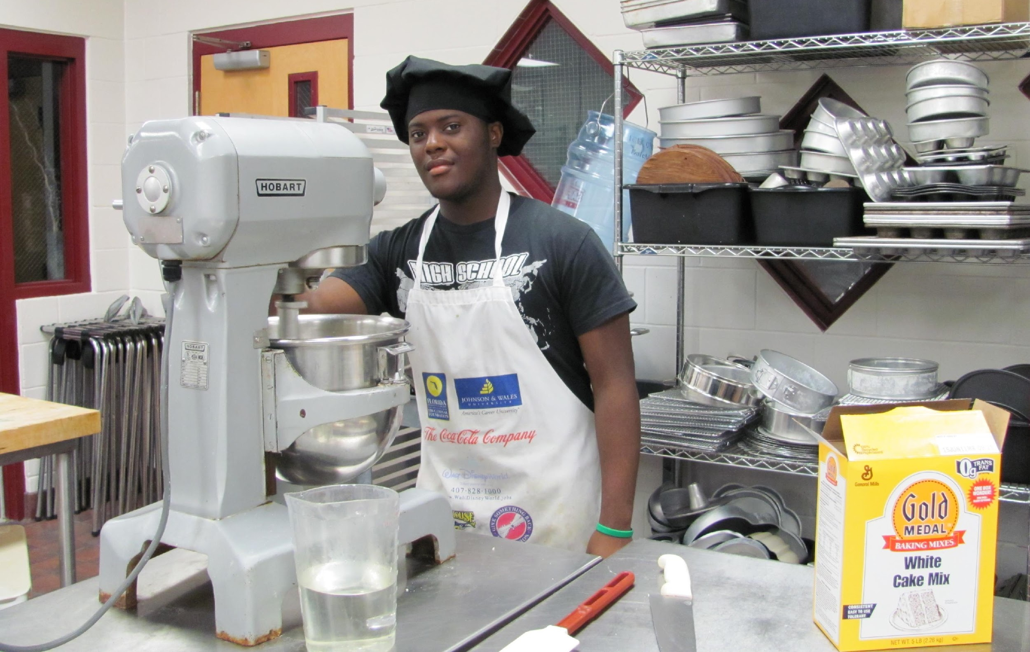
Institute of Culinary Arts
Bakery Chef - Chef - Restaurant Owner/Manager - Food Services Manager - Caterer
Eastside High School

Slide 23
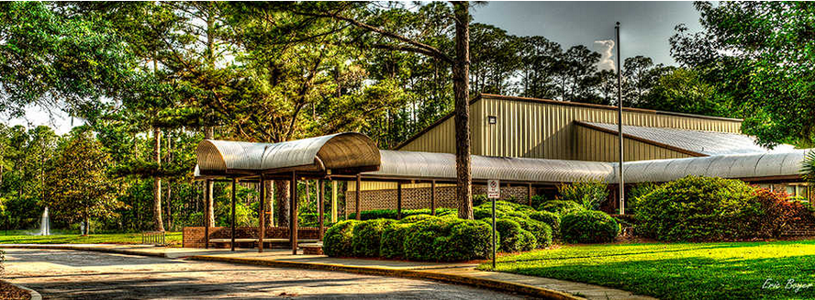
Professional Academies Magnet
Block Schedule = 4 Classes/Semester, Small School Environment, Dual Enrollment,
Play Sports at your ZONED school
Professional Academies Magnet @ Loften High School
Notes:
There are some special things about Loften that make it unique. They have block scheduling so you have the potential to earn 8 credits a year instead of 6. This may allow you to graduate early, start dual enrollment, or get caught up. It is a much smaller school than other high schools so you get to know everyone and they get to know you. Because Loften is a very small school they do not have many sports or extracurriculars BUT you can take an activity bus to your zoned school and participate in sports and other activities there.

Slide 24


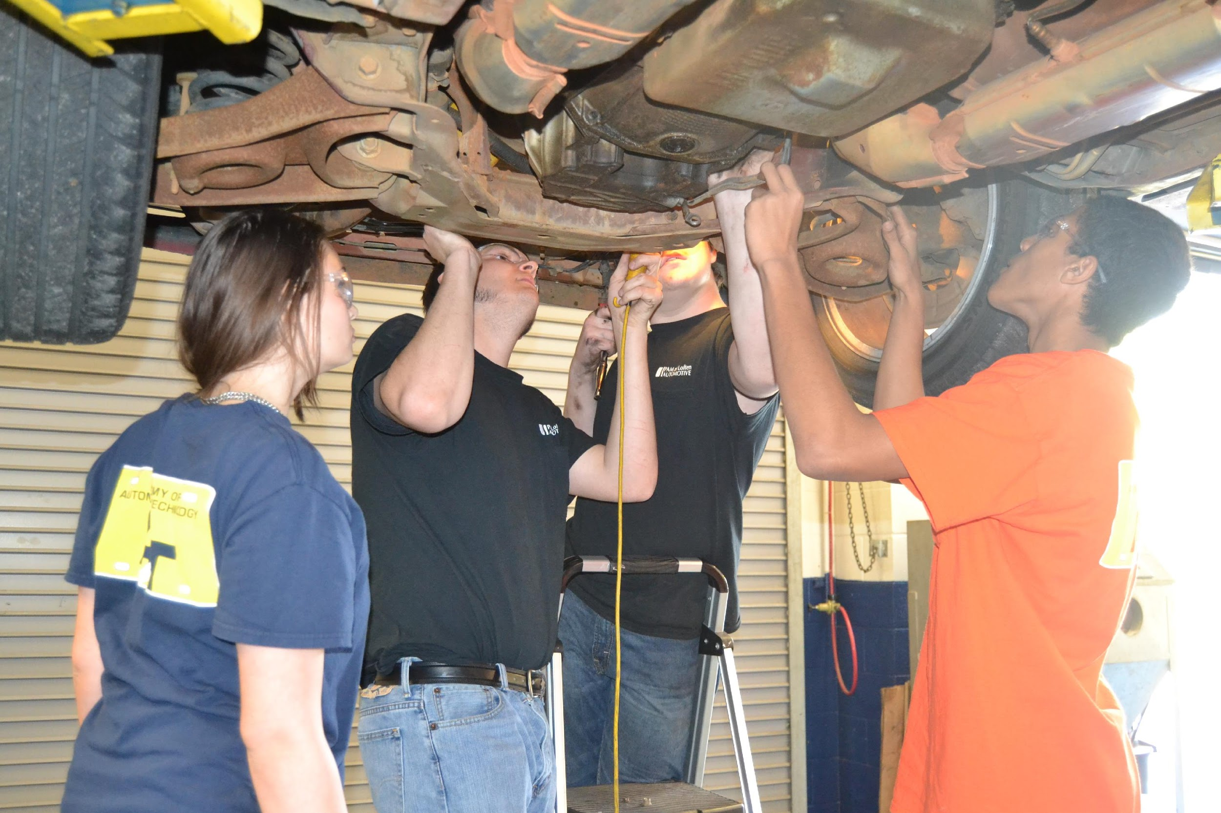
Academy of Automotive Technology
Automotive Technician - Automotive Services Manager
Shop Safety, Electric Systems, Batteries, Suspension and Steering, Brakes, and more!
Professional Academies Magnet @ Loften High School

Slide 25
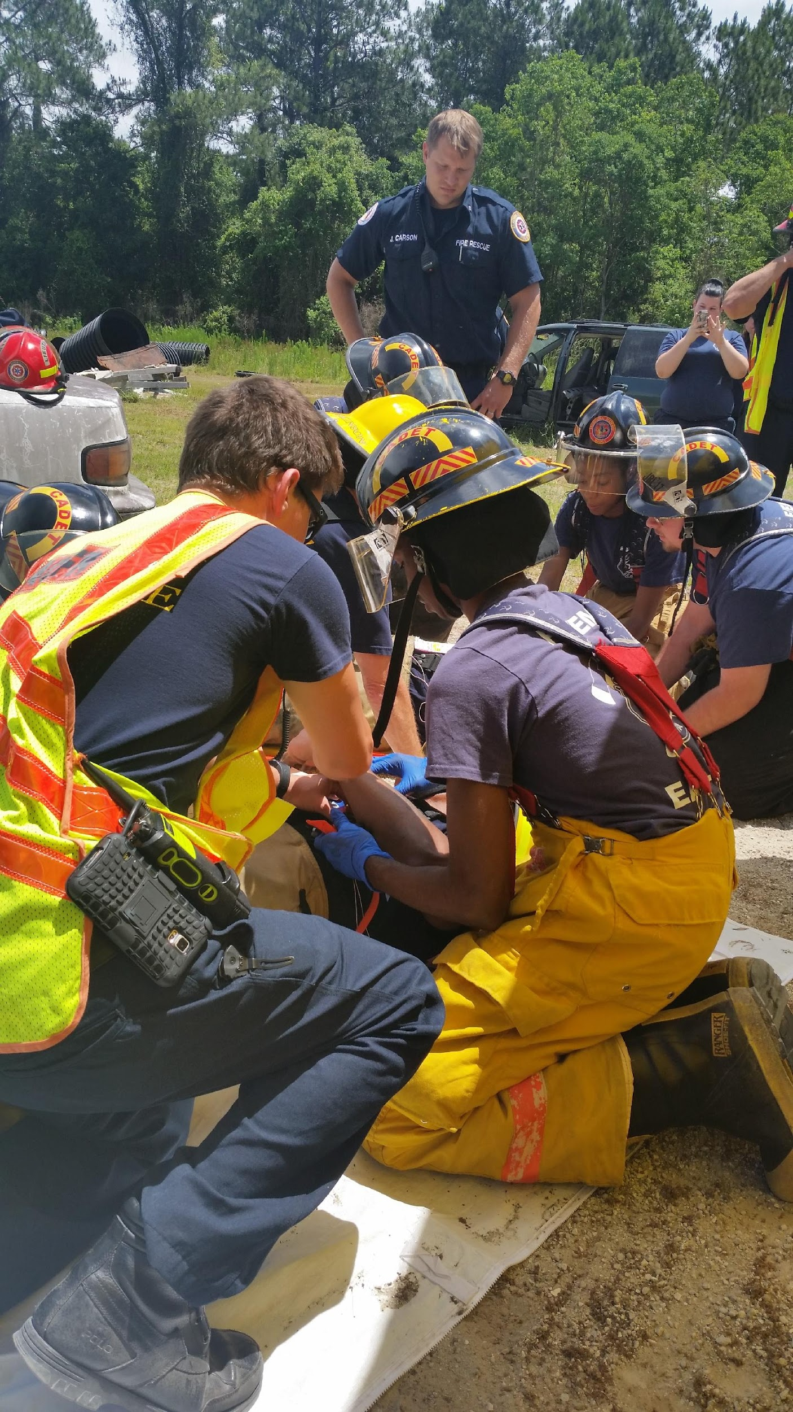
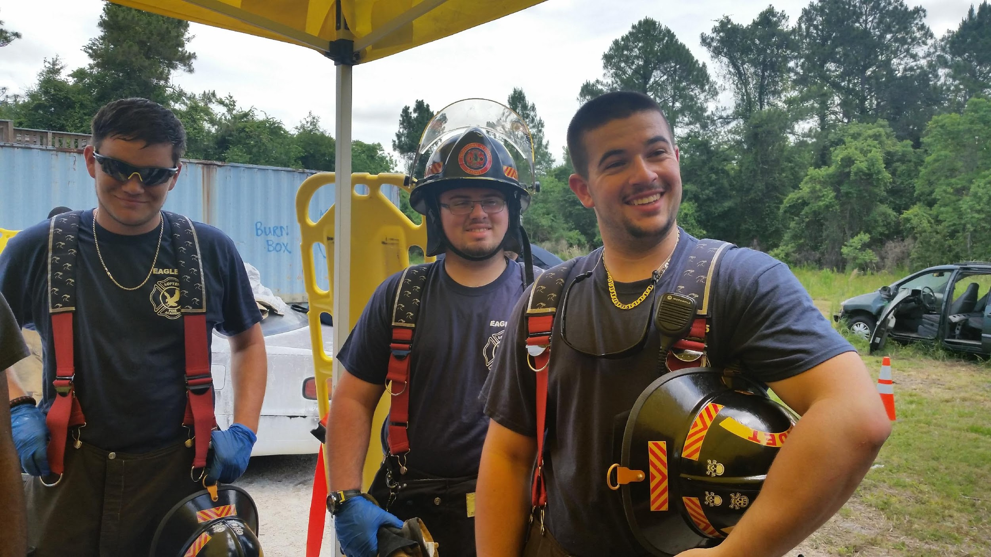
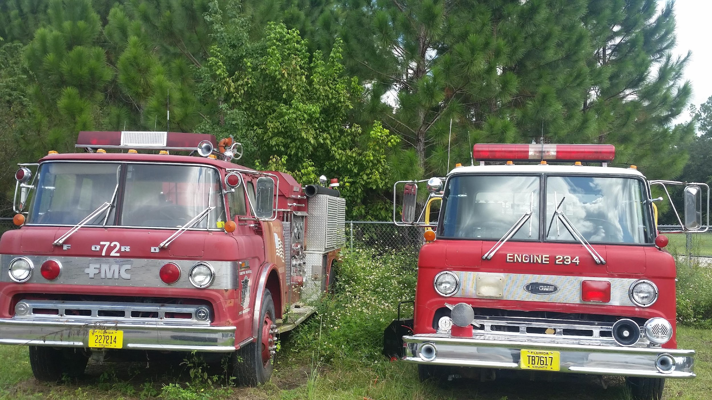

Academy of Fire &
Emergency Medical Services
Emergency Medical Technician - Firefighter - Paramedic
Professional Academies Magnet @ Loften High School

Slide 26
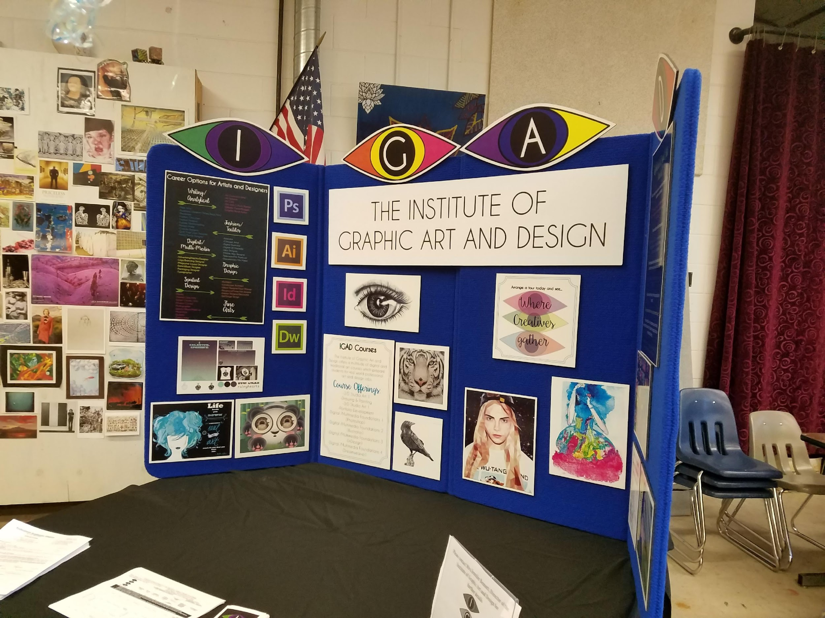


Institute of Graphic Art and Design
Art - Digital Art - Photography - Technology
Professional Academies Magnet @ Loften High School

Slide 27



Academy of Gaming and Mobile Apps
Gaming - Simulation - Animation Programming
Professional Academies Magnet @ Loften High School

Slide 28

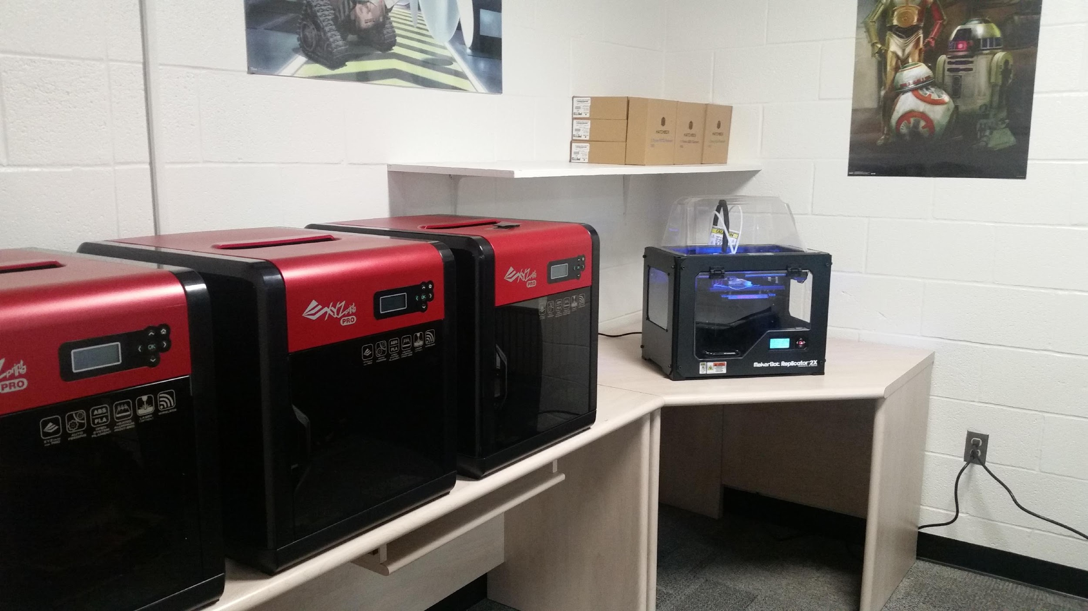
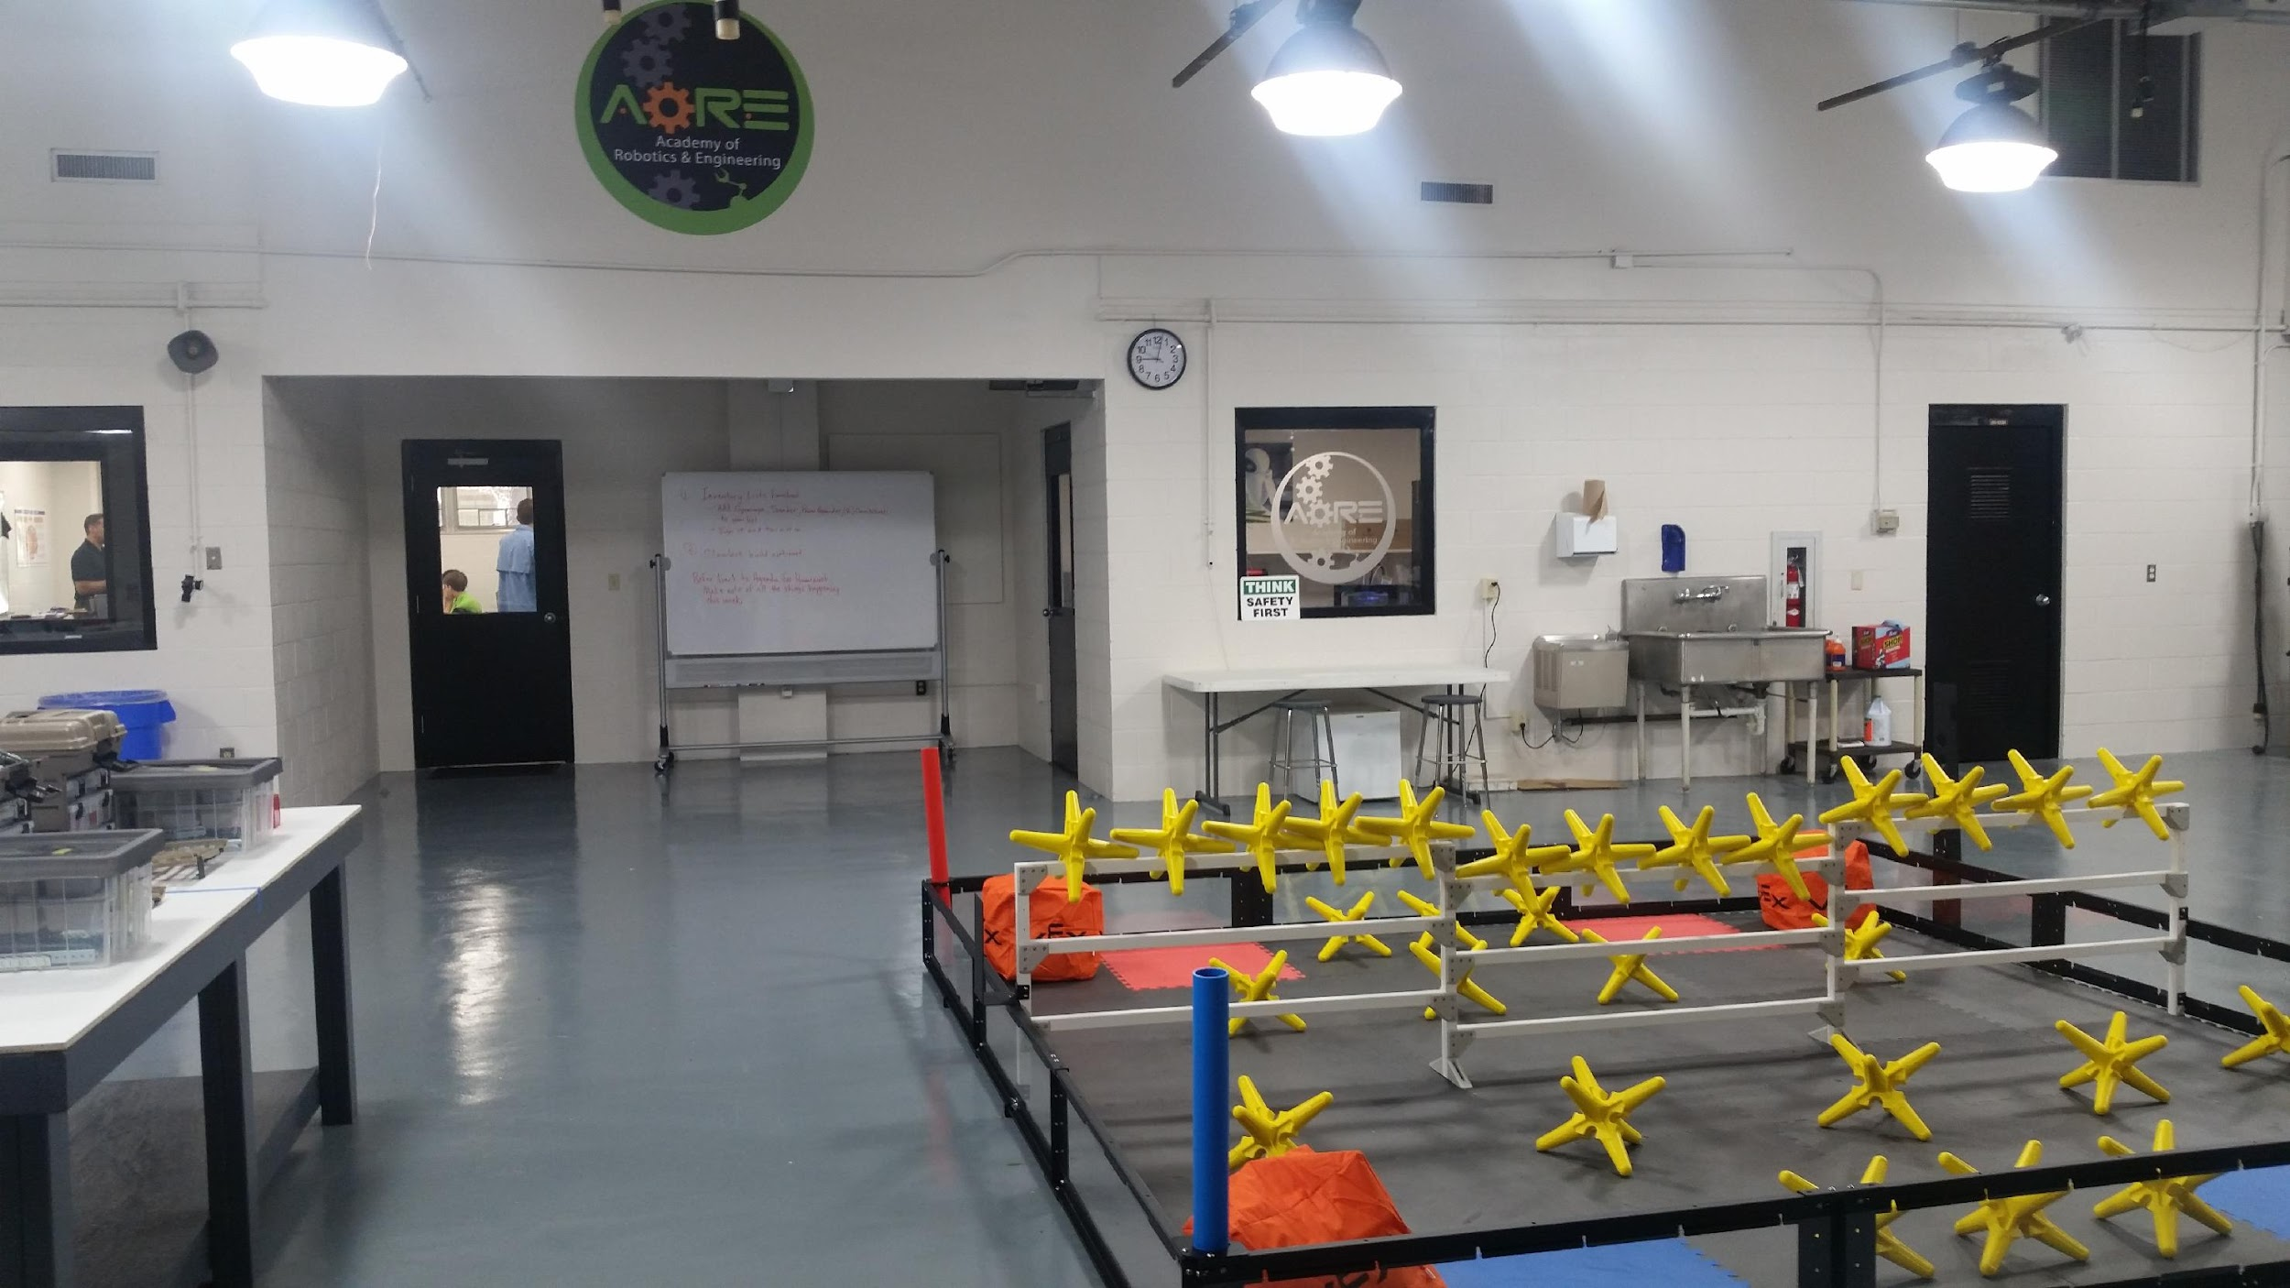
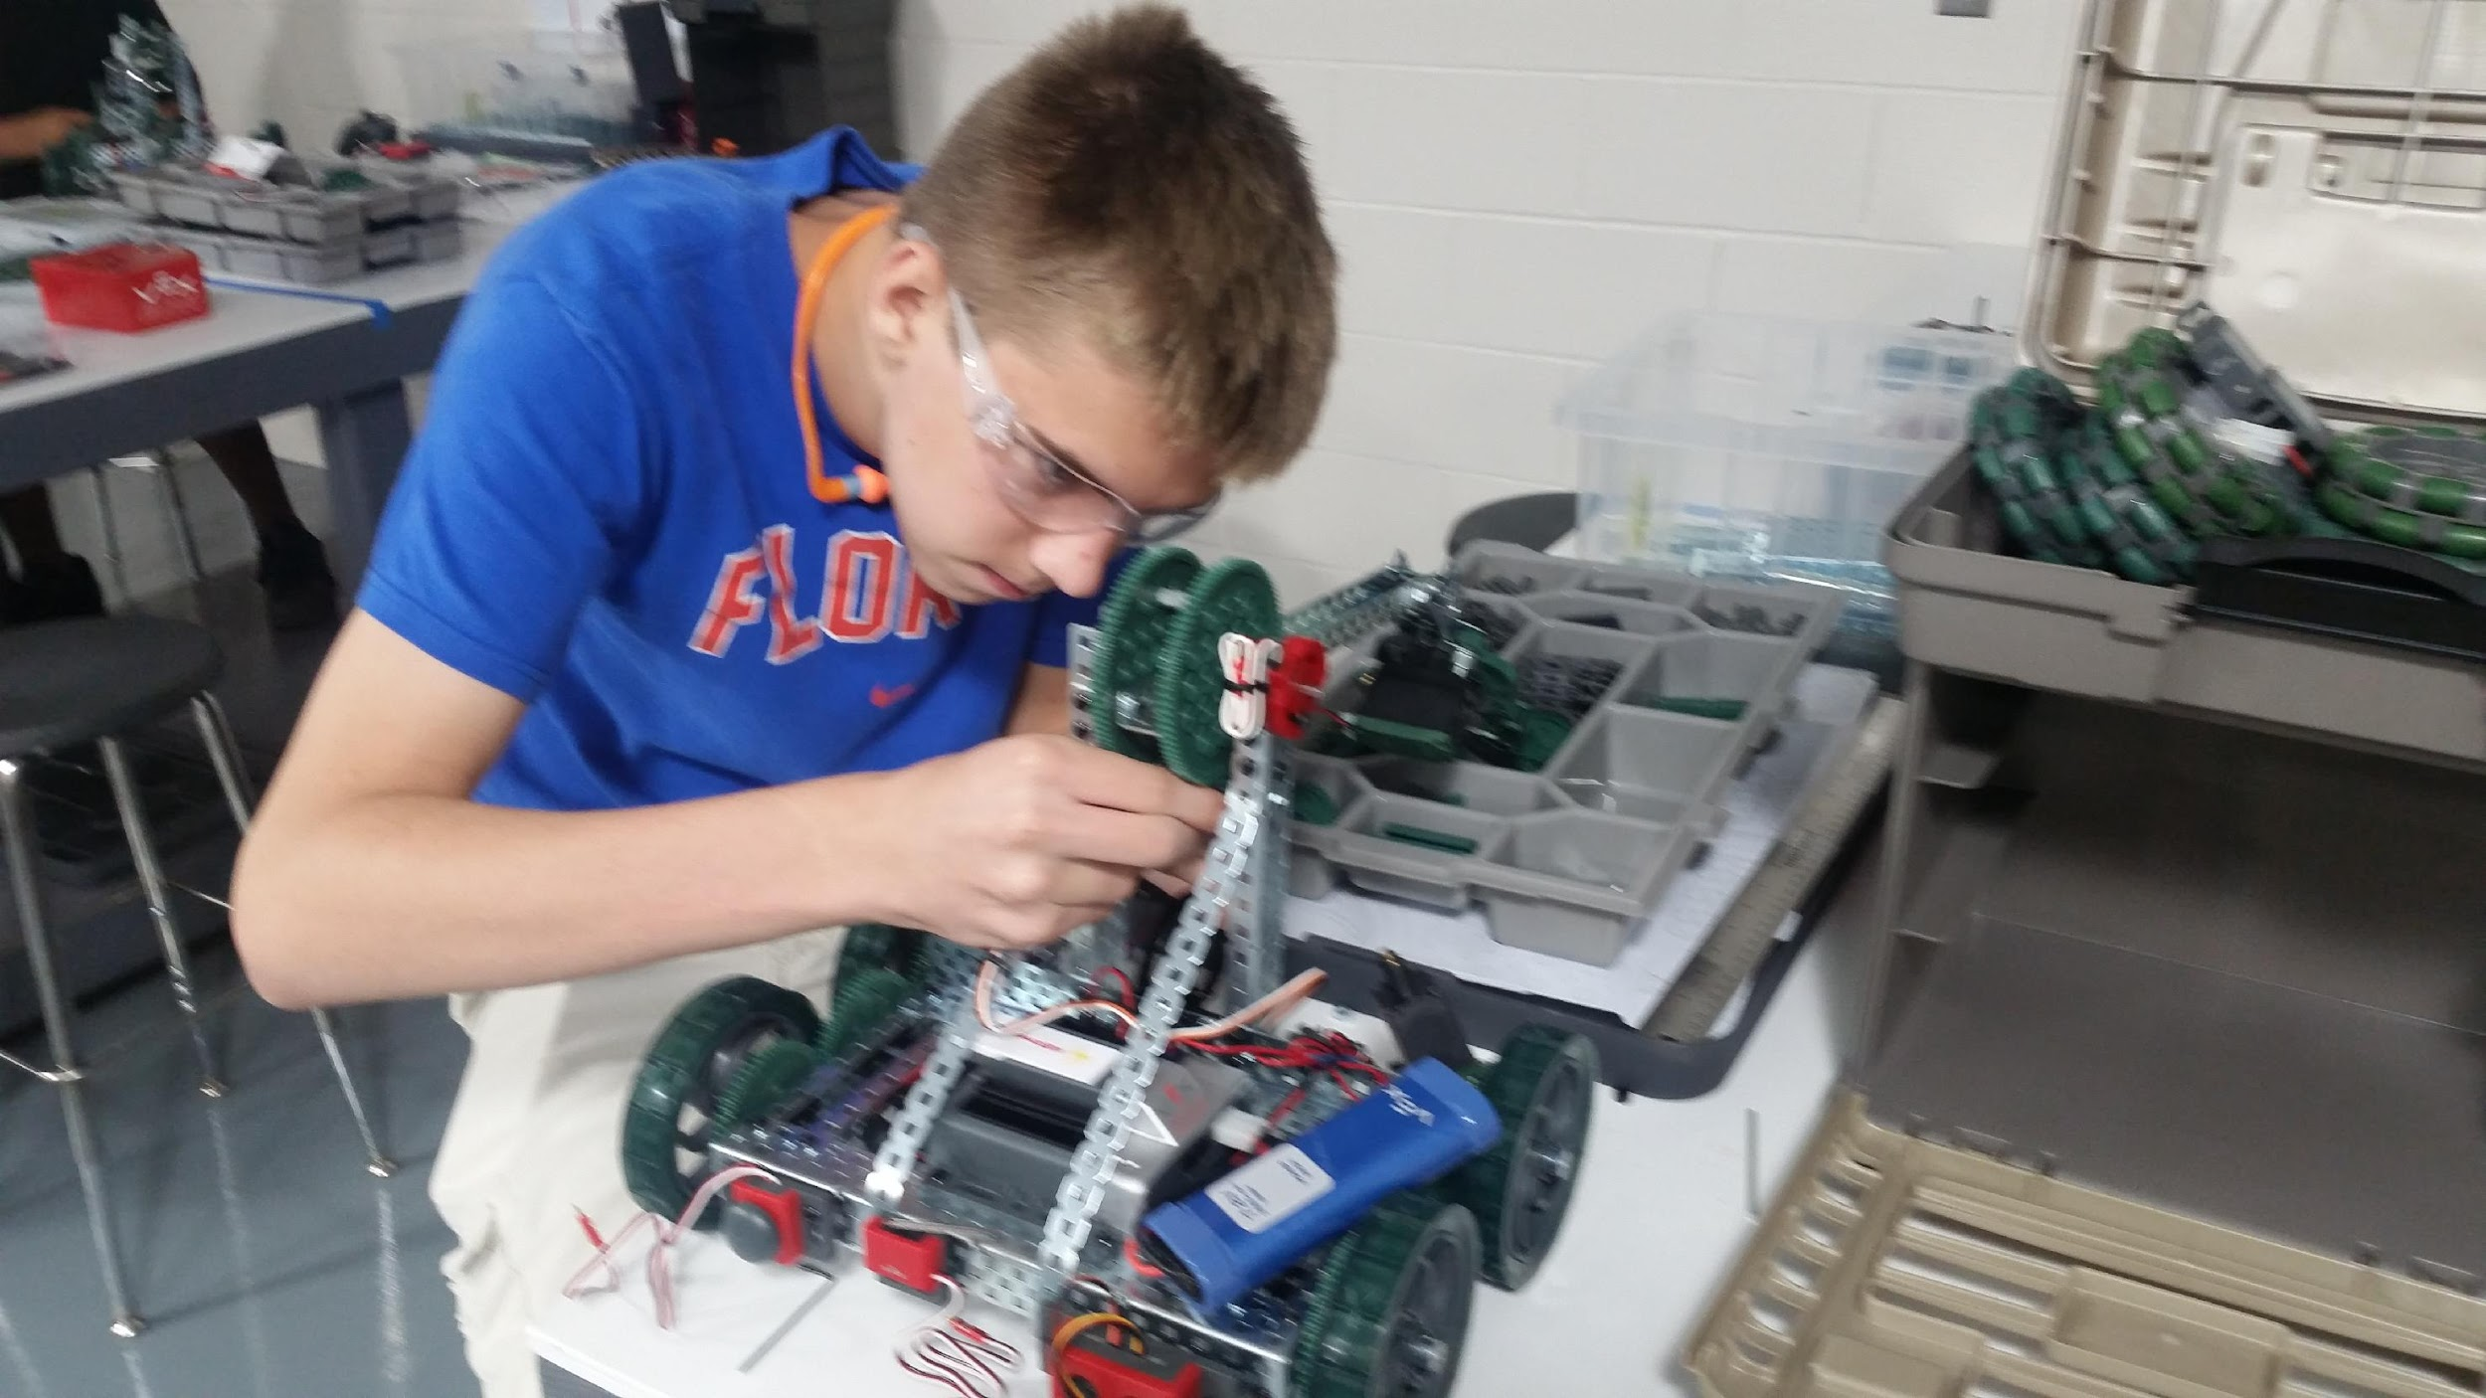
Academy of Robotics & Engineering
Careers in Advanced Manufacturing and Engineering
Professional Academies Magnet @ Loften High School

Slide 29
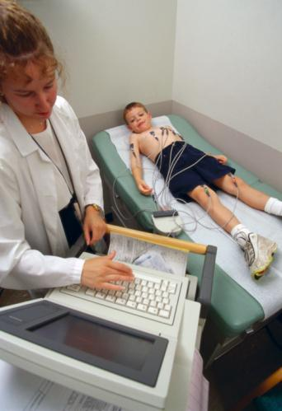
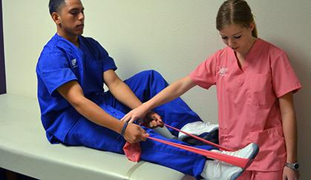

Academy of Health Professions
EKG Aide
Dental Aide
Physical Therapy Aide
Pharmacy Tech
Nursing Assistant
EMT
Athletic Trainer – Nurse - Pharmacist - Physical Therapist - Physician - & More
Gainesville High School
Notes:
Dental Aide was just added back in as an option this year! (2018-19)

Slide 30
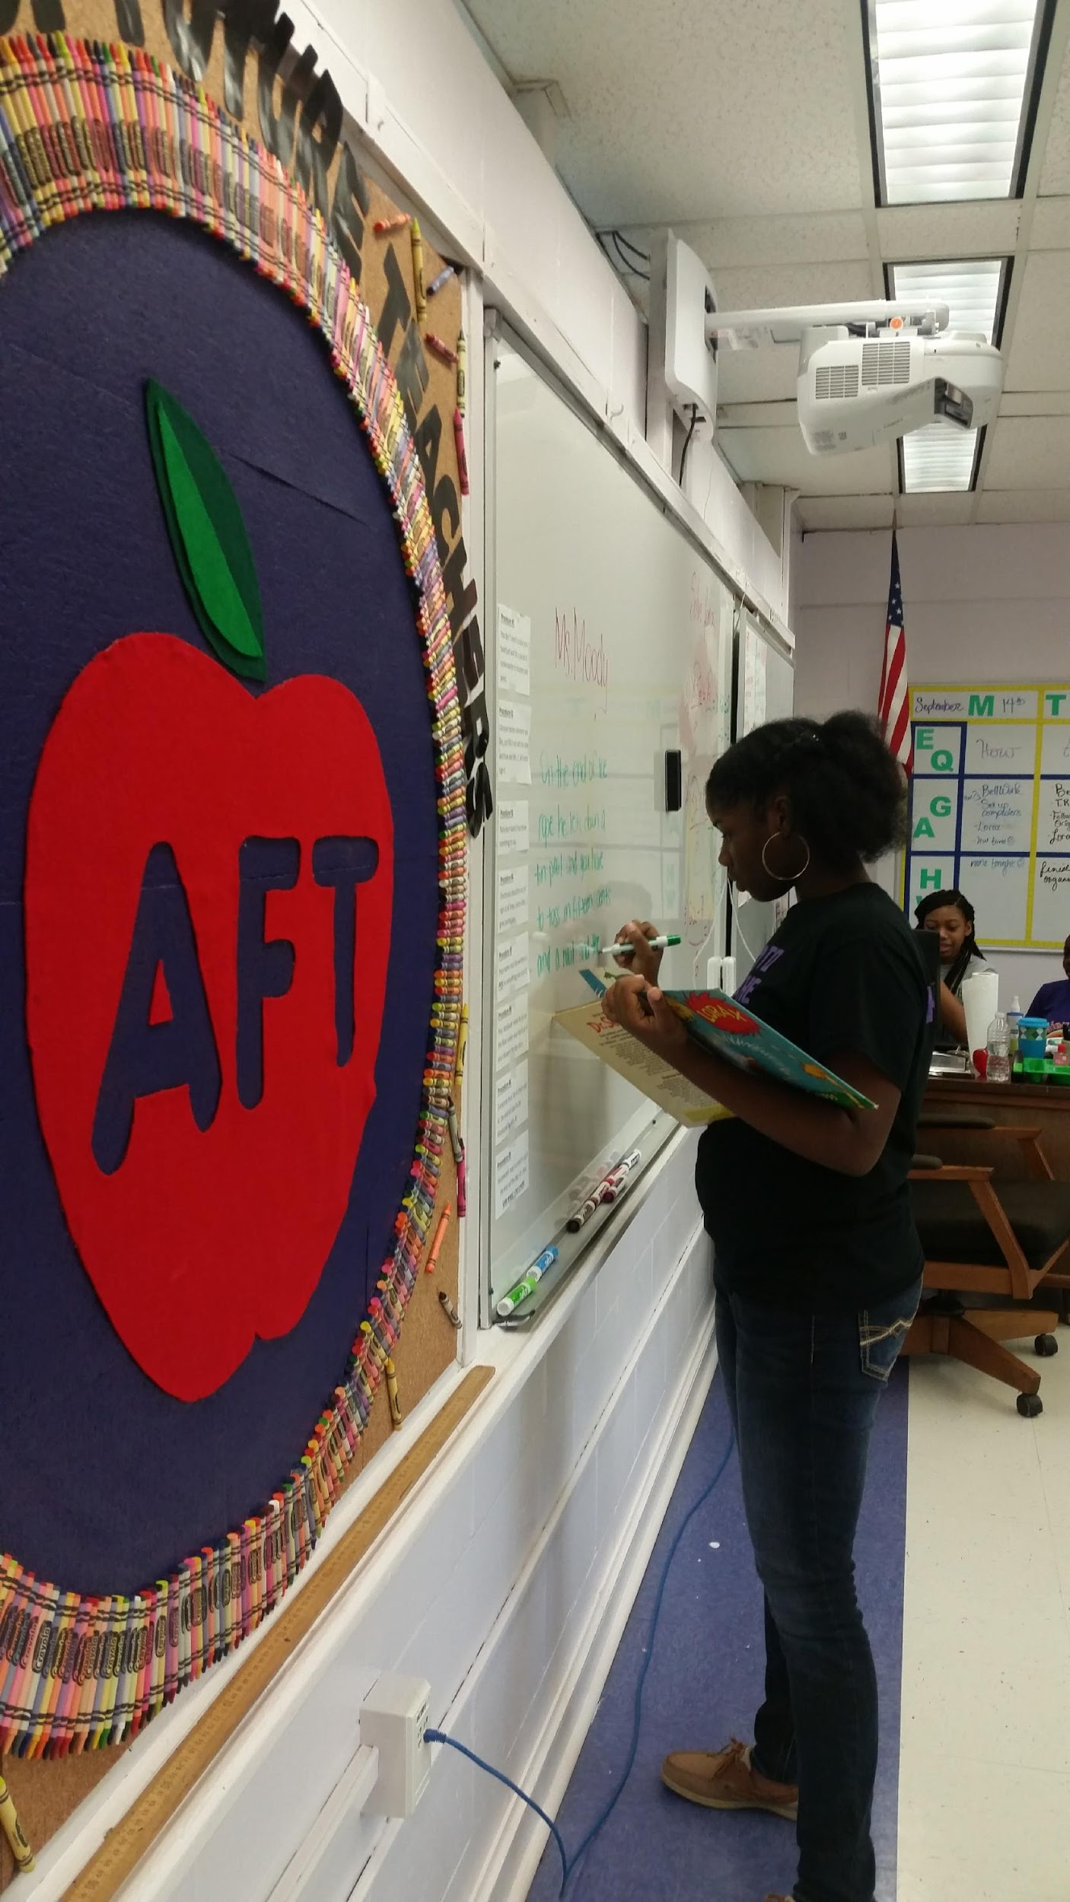
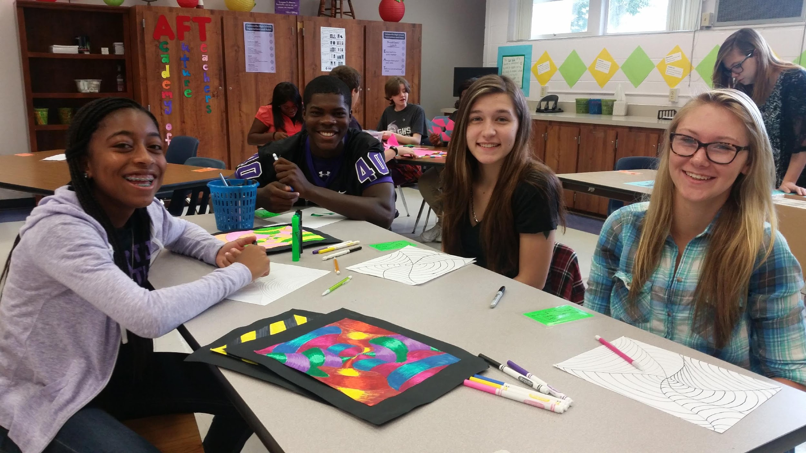
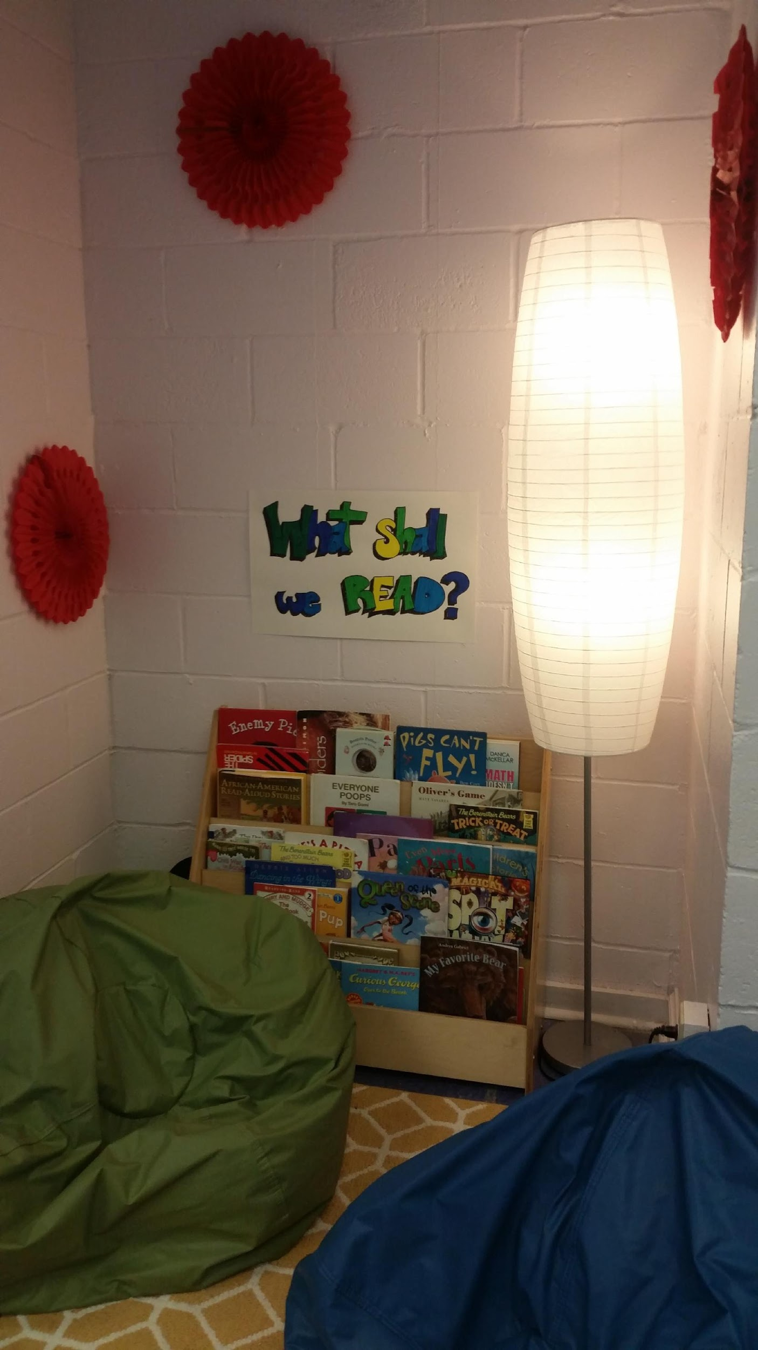

Academy of Future Teachers
Paraprofessional - Teacher - Speech Therapist - Dean - School Administrator
Gainesville High School

Slide 31
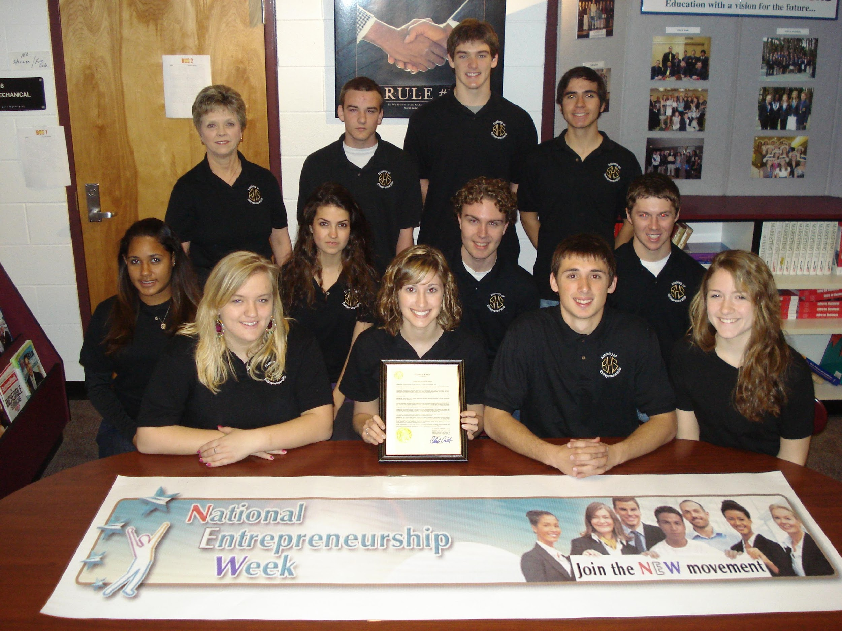
Academy of Entrepreneurship
Business Management/Ownership - Marketing - Sales
Buchholz High School

Slide 32
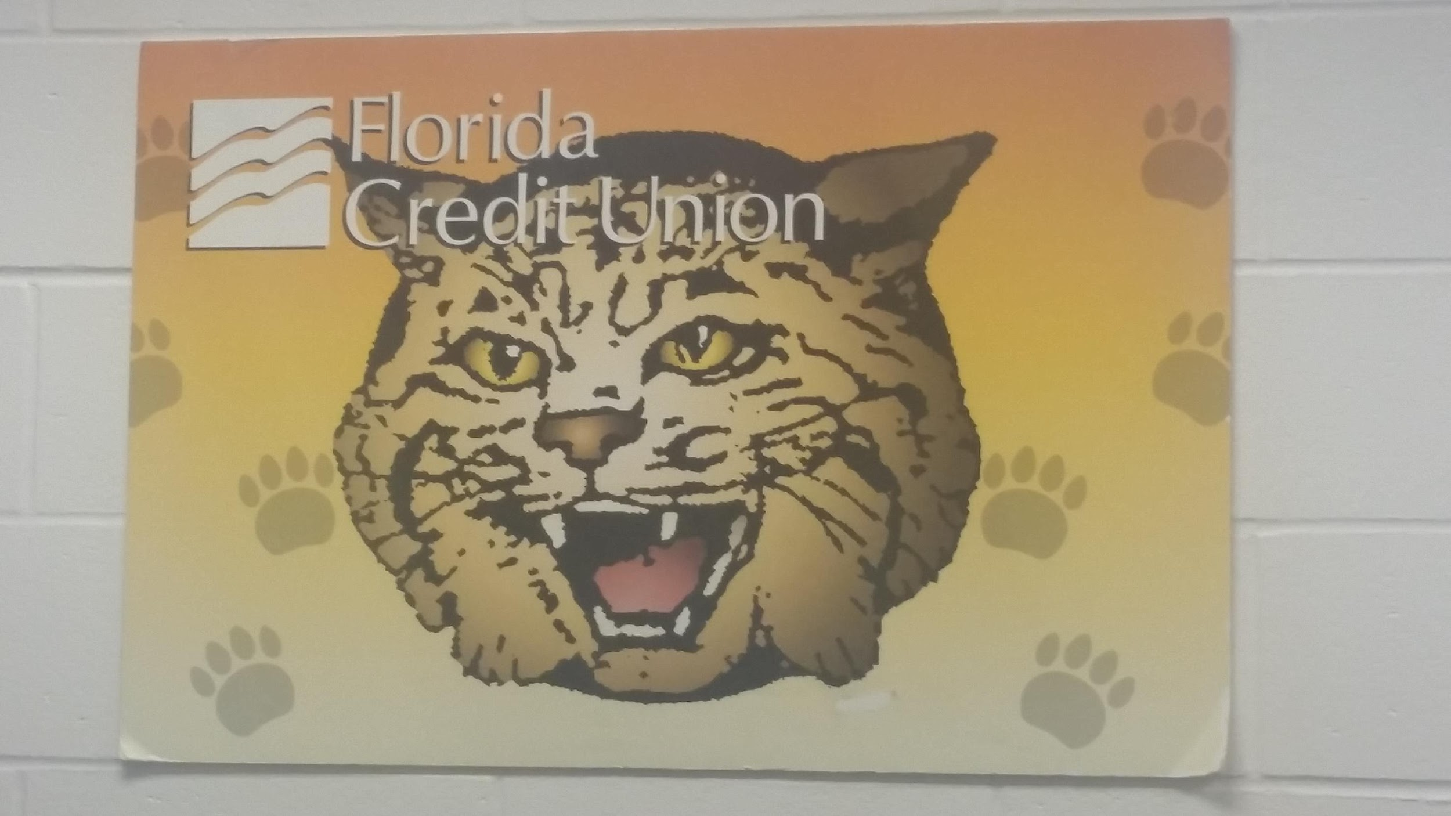
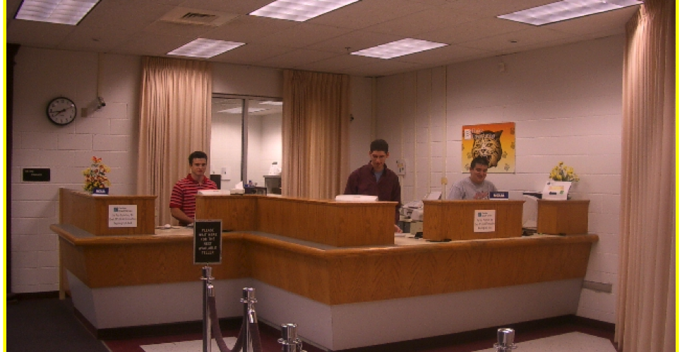
Academy of Finance
Accountant - Bank Teller - Loan Officer - Personal Financial Advisor
Buchholz High School - Branch of the Florida Credit Union

Slide 33
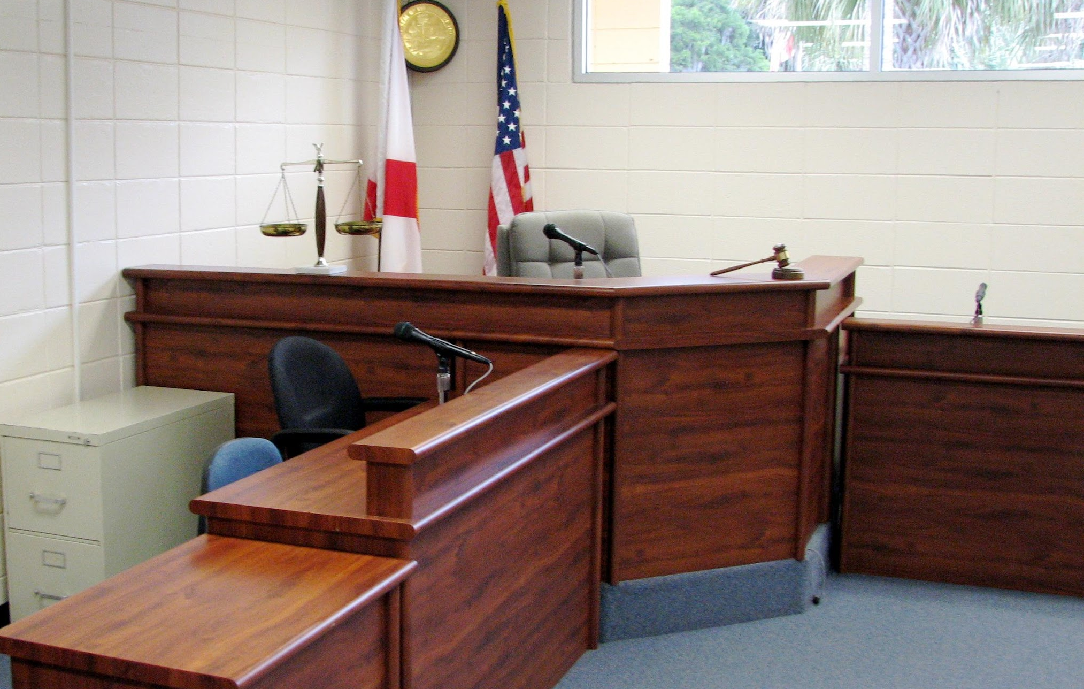

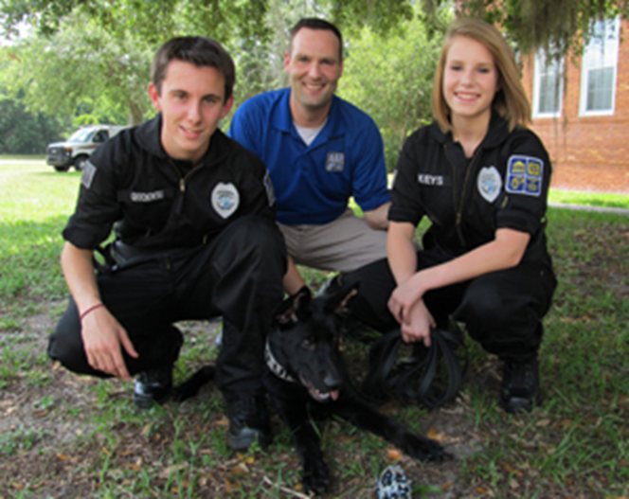
Academy of Criminal Justice Technology
Corrections Officer - Crime Scene Investigator - Lawyer - Paralegal - Police Officer
Newberry High School
Notes:
New K-9 puppy this year!

Slide 34
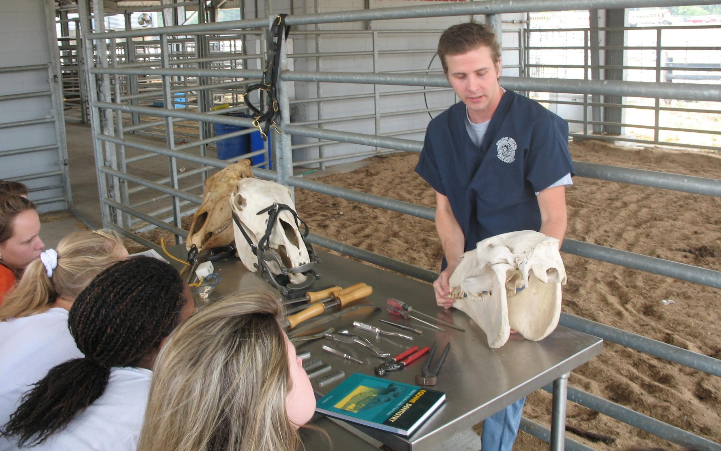
Academy of Agriscience
Forestry Conservation - Veterinarian - Equestrian Studies - Farm Management - Horticulture
Santa Fe High School

Slide 35
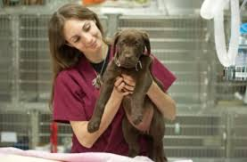
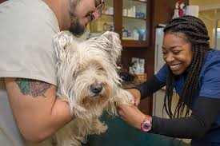
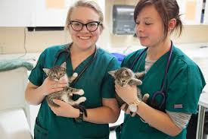
Academy of Veterinary Assisting
Veterinary Assisting - Medical & Clinical Laboratory Technician - Veterinarian
Santa Fe High School

Slide 36
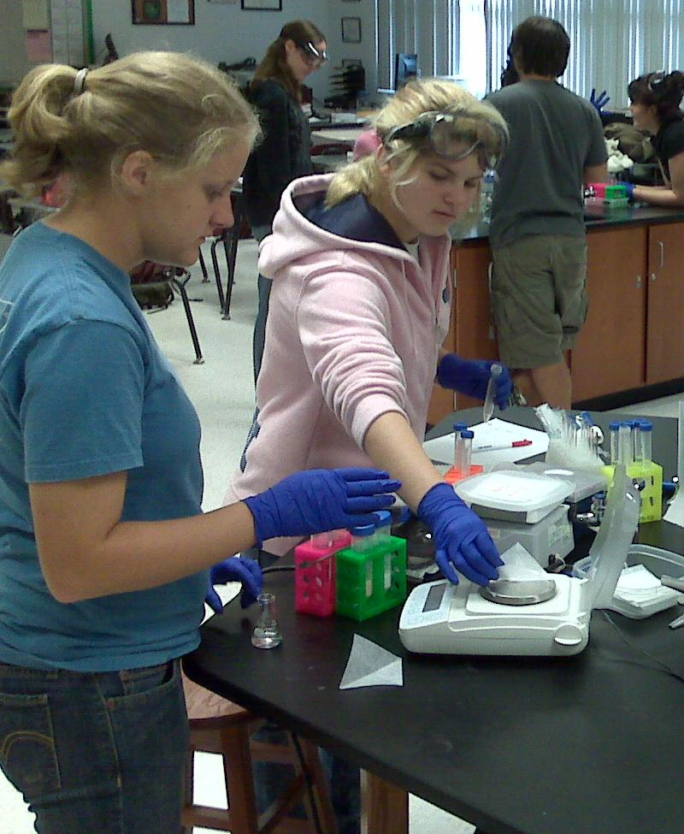
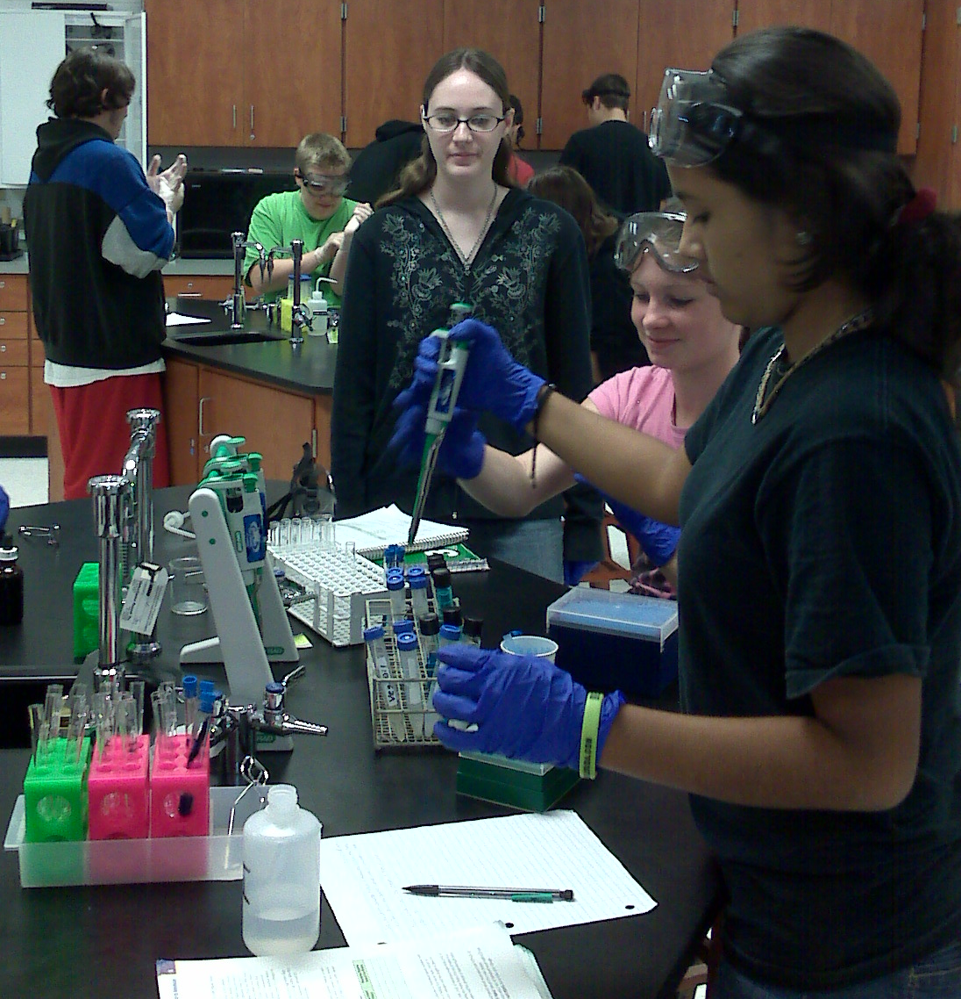
Institute of Biotechnology
Pharmacology – Bioinformatics - Environmental – Agriculture Sciences
Santa Fe High School
Notes:
New, super energetic and fun teacher this year! Mr. Oyama!

Slide 37
Academy of Agribusiness
Hawthorne High School
Greenhouse/Nursery Production - Livestock/Horticulture Production - Animal Feed Cost Management - “A focus on the business and marketing side of the agriculture industry”

Slide 38
Career Academy Showcase
Coming to you soon VIRTUALLY
Learn About Career Academies from Program Directors & Students
Buchholz High School – Academy of Entrepreneurship &
Academy of Finance
Eastside High School – Institute of Culinary Arts
Gainesville High School – Academy of Health Professions
Academy of Future Teachers
Hawthorne High School - Academy of Agribusiness
Newberry High School – Academy of Criminal Justice
Professional Academies Magnet @ Loften High School
- Academy of Automotive Technology
- Academy of Gaming and Mobile Apps
- Institute of Graphic Arts and Design
- Academy of Fire and Emergency Medical Services
- Academy of Robotics and Engineering
Santa Fe High School – Academy of Agriscience
Academy of Veterinary Assisting
Institute of Biotechnology

Slide 39

So How Do I Decide???
Visit…Visit…Visit
Virtual Career Academy Showcase
A link will be emailed to watch at your convenience
Open House Dates in January
Shadowing
Make the decision that is best for you and
create your high school experience!

Slide 40
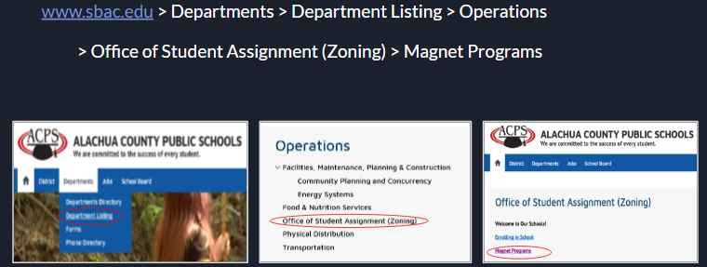
You must apply for ALL academies….. even if you are zoned for that school.
Apply between: January - February
Choose Top 4 - Online Common Application
One Notification Letter for all programs

Slide 41
Process to Apply
Students may apply for multiple programs
  Elementary - up to 4 choices
  Middle - up to 3 choices
  High School - up to 4 choices (any combination)
Program rankings are extremely important!
No changes, including program rankings, can be made to the application after the application deadline.
FSA scores will be waived this year

Slide 42
High School Applications
Applications will include one short answer response for all applications
“Describe something that you are passionate about or something that motivates you”

Slide 43
Tentative magnet application timeline - 2021
January, 2021 - Application Opens
Mid-February, 2021 - Application closes. Any paper applications must be postmarked by this date
March, 2021 - First Notice of Acceptance sent
Additional notices will be sent as seats are available.

Slide 44
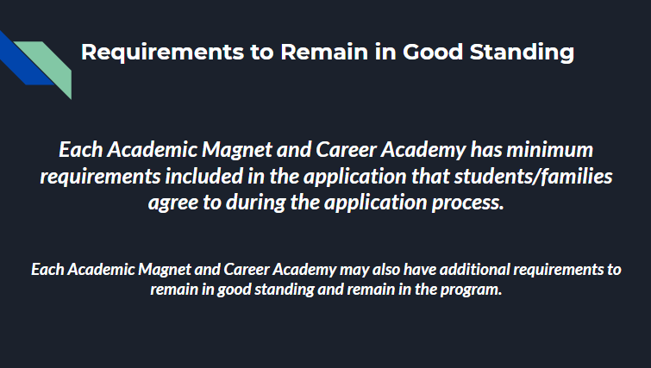

Slide 45
Paying for College
Earn College Credit In High School
College credit courses taken during high school are FREE.
Cost of a 3 hour college course at Santa Fe College: $317
Cost of a 3 hour college course at UF: @ $630

Slide 46
Paying for College
Bright Futures Scholarships
There are now 4 Bright Futures Scholarships:
Florida Academic Scholars
Florida Medallion Scholars Award
Florida Vocational Gold Seal Scholars Award
* NOTE: The Florida Vocational Gold Seal Scholarship can now only be used for students pursuing a Certificate , Associate of Applied Science (AAS), or Associate of Science (AS).
Florida Gold Seal CAPE Scholars Award
* NOTE: A student must earn a minimum of 5 postsecondary credit hours through CAPE industry certifications which articulate for college credit. They may then use the CAPE scholar award for an additional 60 hours toward a bachelor of science degree.
NEW!
Florida Academic Scholars Award – 100% Tuition/Fees + $300 for fall & spring
All other scholarships pay a fixed cost per credit hour based on award level, institution type and credit type.

Slide 47
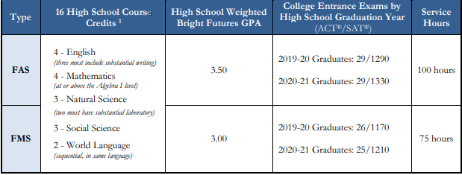
BRIGHT FUTURES SCHOLARSHIP ELIGIBILITY CHART http://www.floridastudentfinancialaid.org/SSFAD/bf/
GPA and ACT /SAT Score Requirements are rising and are subject to change each year.
Specific requirements within the above coursework.
Students who earn an AICE/Cambridge or IB Diploma meet requirements for a Bright Futures Scholarship.

Slide 48
Paying for College
Changes to the Bright Futures Scholarships
ALL BRIGHT FUTURES SCHOLARSHIPS NOW REQUIRE COMMUNITY SERVICES HOURS
All four of these scholarships now require students to complete and document
community hours during high school. Individual high schools can decide what community hours they will accept and the method that is required for documenting those hours.
Florida Academic Scholars Award - 100 hours
Florida Medallion Scholars Award - 75 hours
Florida Vocational Gold Seal Scholars Award - 30 hours
Florida Gold Seal Cape Scholars Award - 30 hours

Slide 49
Paying for College
Changes to the Bright Futures Scholarships
ALL STUDENTS MUST NOW COMPLETE
A FLORIDA FINANCIAL AID FORM
All students must apply for a Bright Futures Scholarship during their senior year PRIOR TO GRADUATION by completing a Florida Financial Aid Form online .
Failure to do so results in students forfeiting Bright Futures Scholarship opportunities.
Funding available for up to 5 years following graduation. (Exceptions made for students entering military or doing full time religious or service work.
If not used initially the scholarship may be reinstated within 2 years.
NOTE: Bright Futures Scholarships requirements are subject to change at the discretion of the Florida Legislature

Slide 50
Paying for College
Federal Student Aid
https://studentaid.ed.gov/
FAFSA
Federal student aid includes:
Grants—financial aid that doesn’t have to be repaid (unless, for example, you withdraw from school and owe a refund)
Loans— borrowed money for college or career school; you must repay your loans, with interest
Work-Study—a work program through which you earn money to help you pay for school
Use FAFSA4caster to get an estimate of how much aid you might receive from the U.S. Department of Education.
Apply for federal student aid using the Free Application for Federal Student Aid (FAFSA®). And remember, the first F in “FAFSA” stands for “free”—you shouldn’t pay to fill out the FAFSA!

Slide 51
Paying for College
Local Scholarships
Santa Fe College Scholarships – January of Senior Year
http://www.sfcollege.edu/development/index.php?section=scholarships
Education Foundation of Alachua County Scholarships – January of Senior Year
https://edfoundationac.awardspring.com/
Search online – Scholarships available for everything!

Slide 52
Alachua County
Education and Career Planning Unit
GRADE 8
Academic and Career Academy Programs
Parent Information Nights
MyCareerShines: Career Interest Inventory
High Demand, High Wage Careers
High School and College Planning
Plan for the Future: High School Planning Guide
High School Registration and Four Year High School Planning

Slide 53
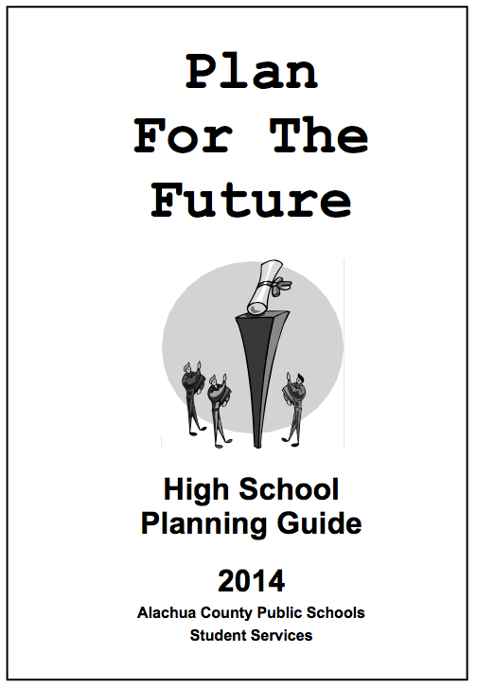
Plan for the Future:
High School Planning Guide

Slide 54
QUESTIONS????
Westwood School Counselors:
Jennifer MacEwan (A-L) macewajj@gm.sbac.edu
Christy Darji (M-Z) darjics@gm.sbac.edu
or
Jennifer Taylor, Supervisor of Student Services
352-955-7671 X1604
taylorjp@gm.sbac.edu

